Slide 1
AML · SPRING 2026 · PROJECT PRESENTATION
Machine Learning for
Portfolio Optimization
From CAPM and Fama–French to ML-driven mean–variance allocation
Peter Wang
Columbia SIPA · Applied Machine Learning

Slide 2
Where factor models and ML each earn their keep
Three roles in the same optimization problem — $w ∝ Σ^{-1}\left(\hat{μ}− R_{f}1\right)$
01
02
03
CAPM
Fama–French
Machine learning
Equilibrium framework
Risk decomposition + attribution
Conditional mean of returns
• Equilibrium claim: under CAPM the cap-weighted market is the tangency portfolio.
• Defines the passive benchmark against which any active strategy is measured.
• β decomposes return into market exposure + idiosyncratic noise — the simplest factor structure.
• Adds size, value, profitability, investment factors — empirically motivated extensions of CAPM.
• Delivers a clean factor-implied covariance Σ = B Λ B′ + D, parsimonious and well-conditioned at Russell-1000 scale.
• Standard language for testing whether a strategy's α is real or a known factor tilt.
• Cross-sectional mapping: f(~94 firm characteristics + 8 macro state vars) → next-month μ̂ (Gu–Kelly–Xiu, 2020).
• Captures nonlinearities and interactions that linear factor models miss; regularization controls overfitting.
• Trained on the full Russell 1000; rolling re-fit tracks regime change.
Factor models build the scaffolding (Σ, equilibrium benchmark, attribution). ML supplies the one piece they handle poorly — μ̂. Both feed the same optimizer.
AML Final Project · Preliminary results · April 2026
2 / 9

Slide 3
Data, sample, and 5-stock illustration set
Russell 1000 powers the ML training; five stocks illustrate the asset-pricing piece
SAMPLE WINDOW
FIVE-STOCK ILLUSTRATION SET
Feb 2010 – Dec 2024 · 179 monthly observations
Ticker
Sector
Role in subset
DATA SOURCES
AAPL
Technology
High-β growth
• Stock prices — yfinance (monthly close, dividend-adjusted). CRSP via WRDS planned for the full project.
• Factor returns — Ken French data library (Mkt–RF, SMB, HML, RMW, CMA, RF).
• Firm characteristics for ML — Compustat (planned); SEC EDGAR + yfinance as fallback feature set.
JPM
Financials
Cyclical, value-tilted
XOM
Energy
Commodity-linked
JNJ
Healthcare
Defensive
UNIVERSE
PG
Consumer Staples
Low-β defensive
Russell 1000 for ML training (cross-sectional power); 5-stock subset for the optimization illustration.
Diversified by sector and factor exposure — gives a varied test of CAPM/FF5 and a non-trivial covariance structure for the optimizer.
AML Final Project · Preliminary results · April 2026
3 / 9

Slide 4
CAPM: one factor, modest fit
Per-stock OLS regressions on (Mkt − Rf), monthly excess returns, 2010–2024
R_{i,t} − R_{f,t} = α_{i} + β_{i} (R_{m,t} − R_{f,t}) + ε_{i,t}
OLS, monthly · i ∈ {AAPL, JPM, XOM, JNJ, PG} · Rₘ = CRSP value-weighted US equity (Ken French) · R_f = 1-month T-bill
Ticker
Sector
β (mkt)
α (% / mo)
R²
RMSE
READING THE TABLE
• JPM has the highest market β (1.22) — financials are pro-cyclical.
• PG and JNJ are the defensive names: β well below 1 and the lowest CAPM R².
• AAPL shows a positive monthly α of +1.13% — but R² is only 0.37, so CAPM leaves a lot unexplained.
• Across all five names, R² ≤ 0.54: clear room for additional factors and ML features.
AAPL
Technology
1.07
+1.13
0.37
0.061
JPM
Financials
1.22
+0.05
0.54
0.050
XOM
Energy
0.87
-0.22
0.30
0.059
JNJ
Healthcare
0.51
+0.15
0.25
0.039
PG
Consumer Staples
0.36
+0.40
0.13
0.040
Excess returns over Rf · 179 months · α reported in monthly percent
AML Final Project · Preliminary results · April 2026
4 / 9

Slide 5
FF5: more factors, materially better fit
Adding SMB, HML, RMW, CMA roughly doubles R² for several names
R_{i,t} − R_{f,t} = α_{i} + β_{i}^{Mkt} (R_{m,t} − R_{f,t}) + β_{i}^{SMB} SMB_{t} + β_{i}^{HML} HML_{t}
+ β_{i}^{RMW} RMW_{t} + β_{i}^{CMA} CMA_{t} + ε_{i,t}
OLS, monthly · all factors from Ken French (2x3 sorts) · Mkt = CRSP value-weighted US equity
Ticker
β Mkt
β SMB
β HML
β RMW
β CMA
α (% / mo)
R² (FF5)
ΔR² vs CAPM
AAPL
1.13
-0.01
-0.51
+0.84
-0.20
+0.75
0.47
+0.10
JPM
1.13
-0.25
+1.21
-0.79
-0.59
+0.55
0.74
+0.21
XOM
0.87
+0.08
+0.62
+0.09
+0.74
-0.16
0.52
+0.23
JNJ
0.63
-0.17
-0.19
+0.29
+0.75
-0.12
0.37
+0.12
PG
0.54
-0.37
-0.24
+0.54
+0.80
-0.03
0.39
+0.25
α t-stats are not significant for any name at the 5% level once FF5 controls are included — exactly the pattern Fama–French were after.
Largest R² gains: JPM (+0.21, value-tilted financial) and XOM (+0.23, picks up CMA / value loadings) — the names CAPM was furthest off on.
AML Final Project · Preliminary results · April 2026
5 / 9

Slide 6
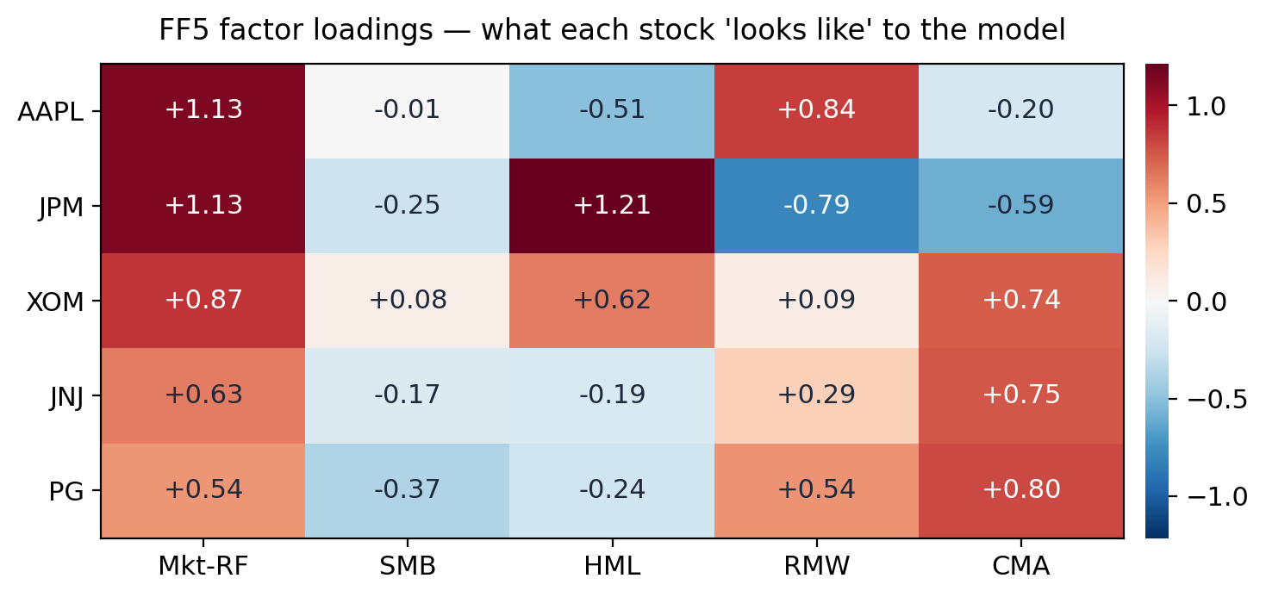
Each stock has its own factor fingerprint
FF5 loadings reveal economic exposures that CAPM collapses into a single β
ECONOMIC READING
• JPM: strong + HML, − RMW — classic value-tilted, low-profitability financial.
• AAPL: + RMW, − HML — high-quality growth, low book-to-market.
• XOM: + CMA, + HML — value + low-investment, consistent with mature energy.
• PG / JNJ: + CMA — defensive, capital-disciplined firms.
• These exposures look very different across stocks. A single market β cannot capture them.
AML Final Project · Preliminary results · April 2026
6 / 9

Slide 7
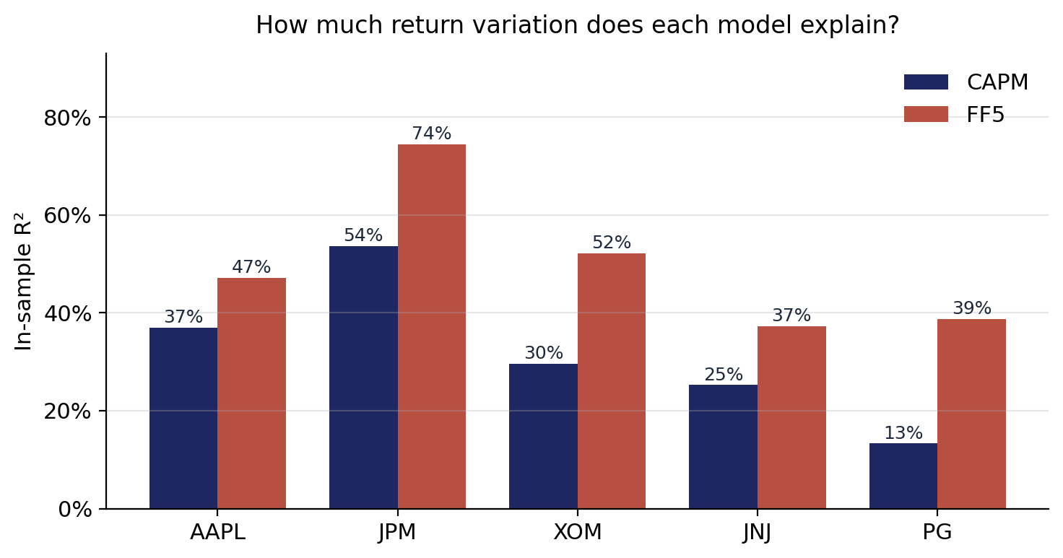
FF5 wins on every stock — but R² caps below 0.75
In-sample R² comparison; the gap is what motivates a richer model
AVERAGE R² GAIN
+18 pp
CAPM 32% → FF5 50%, mean across 5 stocks
WHAT FF5 STILL MISSES
• Highest FF5 R² is 0.74 (JPM) — meaningful idiosyncratic variance remains.
• Linear in five hand-picked factors; no momentum, quality interactions, or macro state.
• Fit is in-sample. Out-of-sample MSFE is the real benchmark for portfolio choice.
AML Final Project · Preliminary results · April 2026
7 / 9

Slide 8


Why ML, and where it fits
Factor models are time-series regressions per stock — ML is the cross-sectional feature-to-prediction map that fills the gap
METHODOLOGICAL FOUNDATION
Gu, Kelly & Xiu (2020), Empirical Asset Pricing via Machine Learning · Review of Financial Studies 33(5): 2223–2273
WHAT FACTOR MODELS CAN'T DO ALONE
WHAT ML ADDS
• CAPM and FF5 are time-series OLS regressions per stock. They give you each stock's β, not a general formula.
• $E\left[r_{i}\right]= α_{i}+ β_{i}· E\left[F\right]$requires assuming $E\left[F\right]$ going forward — the loadings don't tell you the premia.
• Historical-mean $E\left[F\right]$ forecasts barely beat zero out-of-sample (Welch–Goyal 2008; Campbell–Thompson 2008).
• ARIMA on monthly factor returns degenerates to ARMA(0,0,0) — it just reproduces the historical mean.
• Bottom line: factor models describe risk well, predict $\hat{μ}$ poorly.
• Cross-sectional mapping: $f(\sim 94 firm characteristics + 8 macro state vars)$→ next-month ${\hat{μ}}_{i,t+1}$
• Generalizes across stocks — applies to any name whose features can be computed.
• Captures nonlinearities and interactions that linear factor models miss.
• Regularization (Ridge / Lasso) controls overfitting at high feature width.
• Rolling-window training tracks regime change; refit annually.
• Methodological template: Gu, Kelly & Xiu (2020), Empirical Asset Pricing via Machine Learning.
FF5 doesn't go away — it becomes the attribution lens. Regress the ML strategy's monthly returns on FF5; the residual α tells you whether ML is generating real alpha or just buying known factor tilts.
AML Final Project · Preliminary results · April 2026
8 / 9

Slide 9
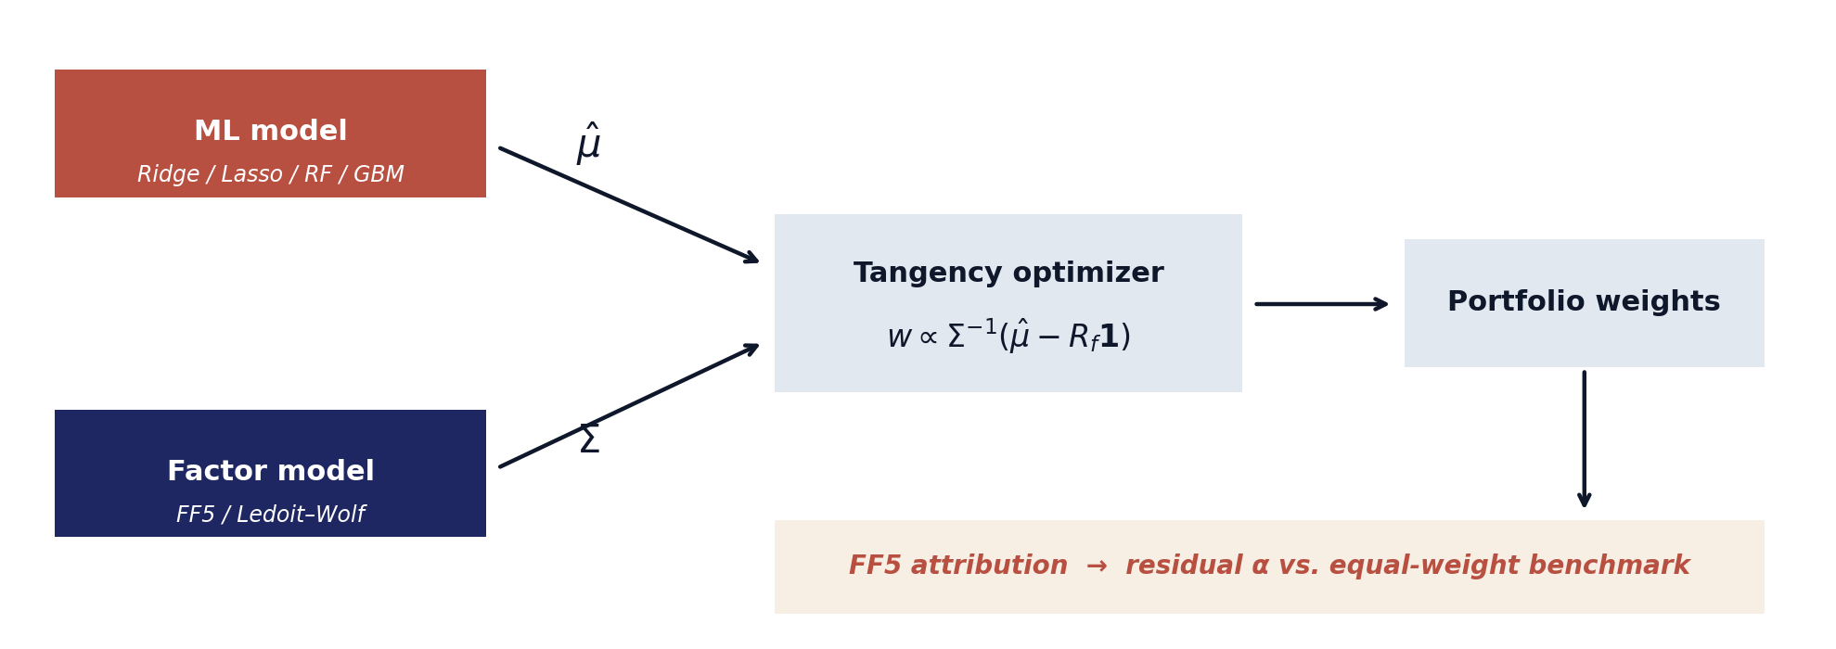
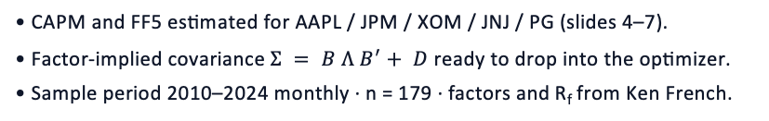
The full pipeline
ML supplies $μ$̂, factor model supplies $Σ$, FF5 evaluates the result
BUILT TODAY (Σ SIDE)
PENDING (MEAN FORECAST + EVALUATION)
• CAPM and FF5 estimated for AAPL / JPM / XOM / JNJ / PG (slides 4–7).
• Factor-implied covariance $Σ = B Λ B^{′}+ D$ready to drop into the optimizer.
• Sample period 2010–2024 monthly · n = 179 · factors and R_{f} from Ken French.
• ML model trained on Russell 1000 cross-section to deliver μ̂.
• Tangency weights for the 5-stock subset; comparison vs. equal-weight benchmark.
• FF5 attribution: residual α and t-stat — is the ML strategy real, or just factor tilts?
AML Final Project · Preliminary results · April 2026
9 / 9

